Slide 1

AIRBNB
ZURICH
Aishwarya Malhotra

Slide 2

TABLE OF CONTENTS
·01·
·05·
·02·
·06·
·03·
·07·
·04·
·08·
DATA PREPARATION
NAIVE BAYES
DATA VISUALIZATION
CLASSIFICATION TREE
LINEAR REGRESSION
CLUSTERING
K-NN
CONCLUSIONS

Slide 3

·01·
DATA PREPARATION

Slide 4
PROCESS
Identified columns necessary for our analysis and imputed missing values
Imputation strategy:
Price
Imputed using mean price for the specific district (Kreis) and neighborhood.
Ensures pricing consistency within the same geographical area.
Beds
Shared Room:
Assumes one bed per person in shared accommodations.
Private Room or Entire Apartment:
Accommodates 1 or 2:
Beds set to 1.
Accommodates 3 to 8:
Beds = Accommodates/2

Slide 5
FEATURE ENGINEERING
New Variables:
Guest per bath: indicating bathroom accessibility and potential congestion
Guests per bed: reflecting sleeping arrangements and comfort
Price per guest: provides insights into affordability and value for money

Slide 6
SUMMARY STATISTICS
High Supply
District 11- Oerlikon- 134
District 1- Rathaus-129
Low Supply
District 12- Saatlen- 8
Most affordable
District 11- Affoltern @46.9 CHF per guest
Expensive
District 1- City @146.6 CHF per guest
Price Variability
High-District 1- City and Lindenhof
Low - District 2- Leimbach

Slide 7
SUMMARY STATISTICS
Availability in next 30 days
No Private rooms in City
No Shared rooms in Schwamendingen-Mitte and Gewerbeschule
No Hotel rooms in Langstrasse

Slide 8
·02·
DATA VISUALIZATION

Slide 9
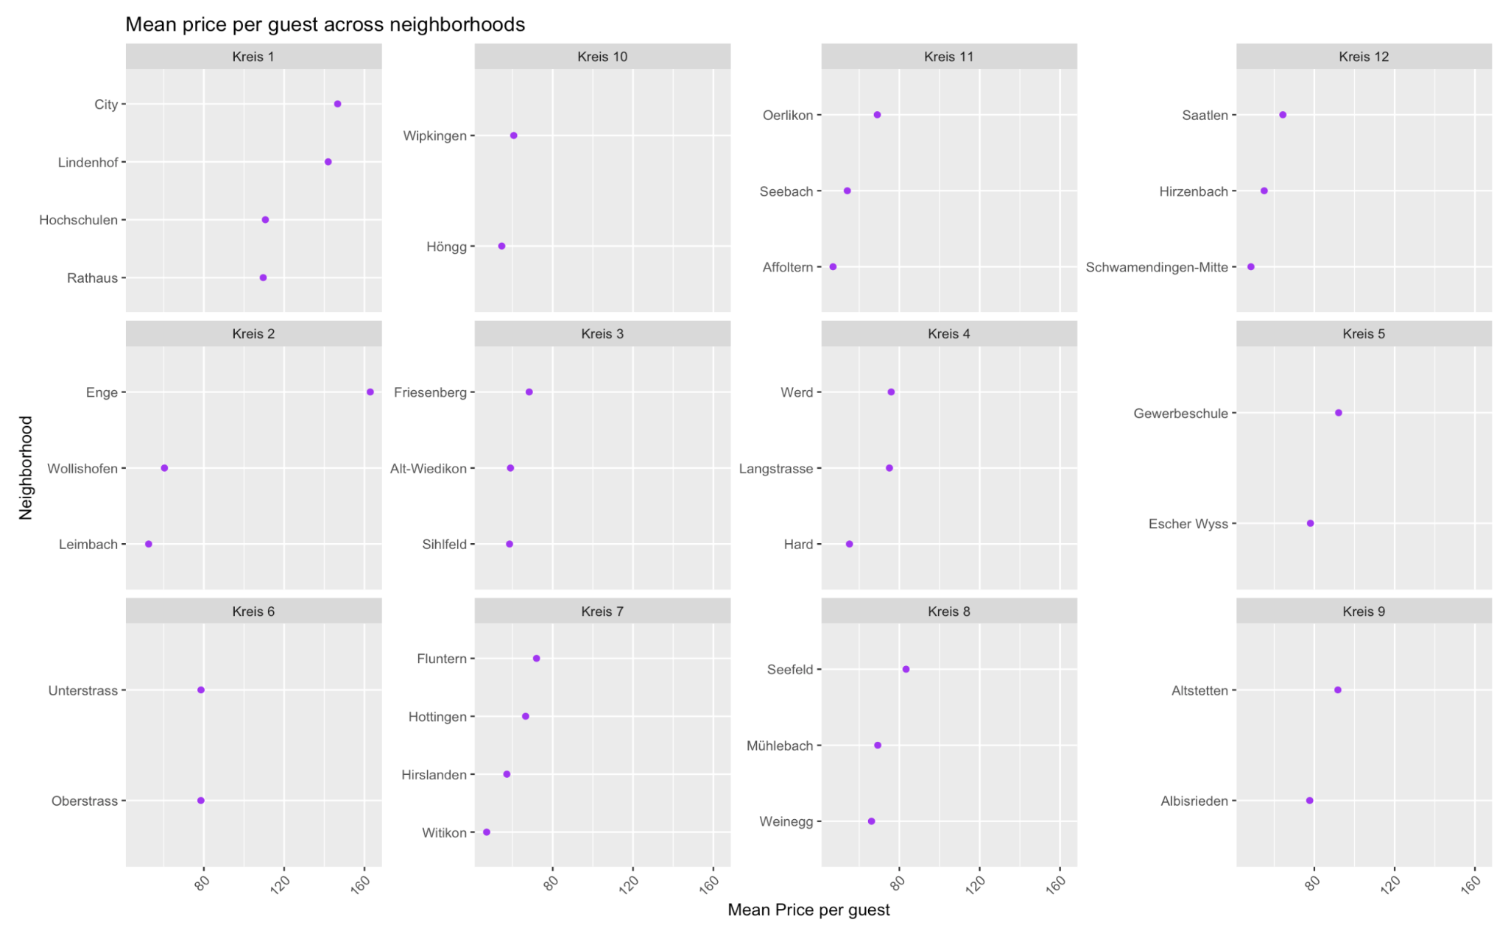
AFFORDABILITY
Most affordable -Affoltern
@46.9 CHF per guest
Expensive - City
@146.6 CHF
per guest

Slide 10
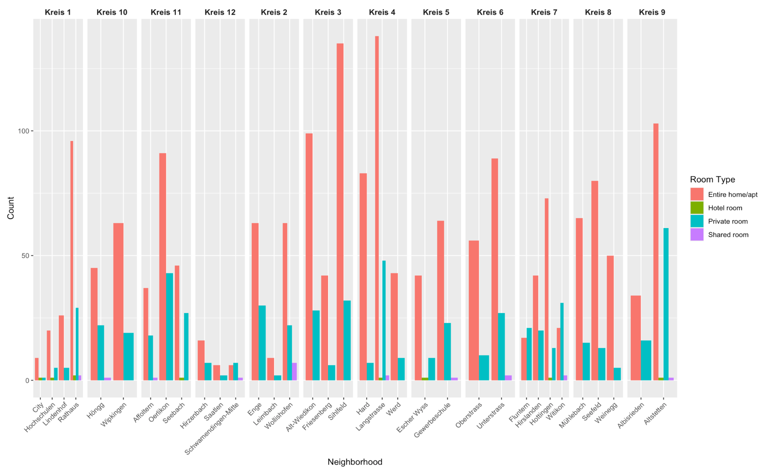
OVERALL SUPPLY
District 11- Oerlikon- 134
District 1- Rathaus-129
Lowest supply:
District 12- Saatlen- 8

Slide 11
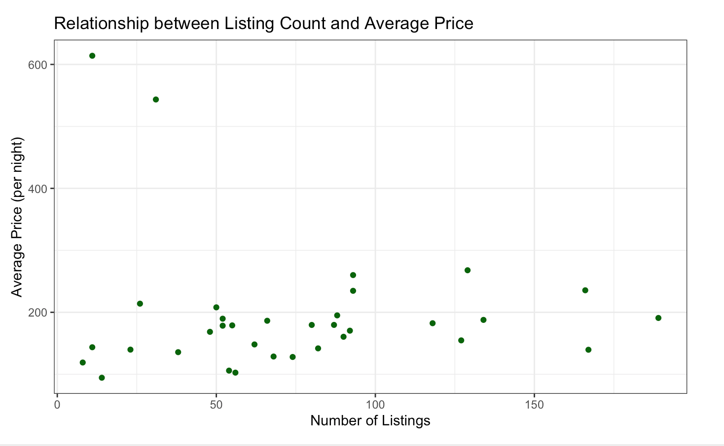
RELATION BETWEEN LISTINGS AND AVERAGE PRICE
Higher prices could be due to high demand

Slide 12
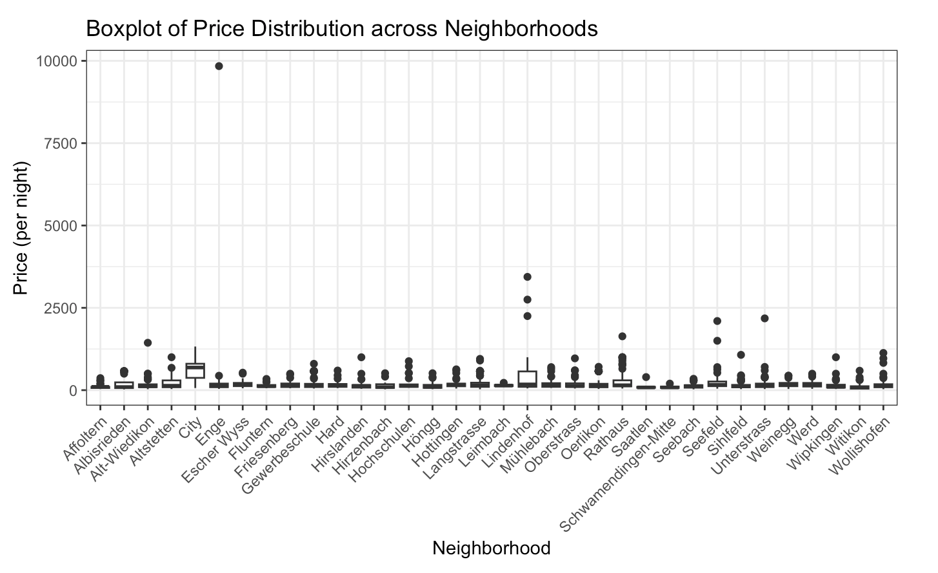
PRICE VARIATION
High price variation:
City and Lindenhof
Low - District 2- Leimbach

Slide 13
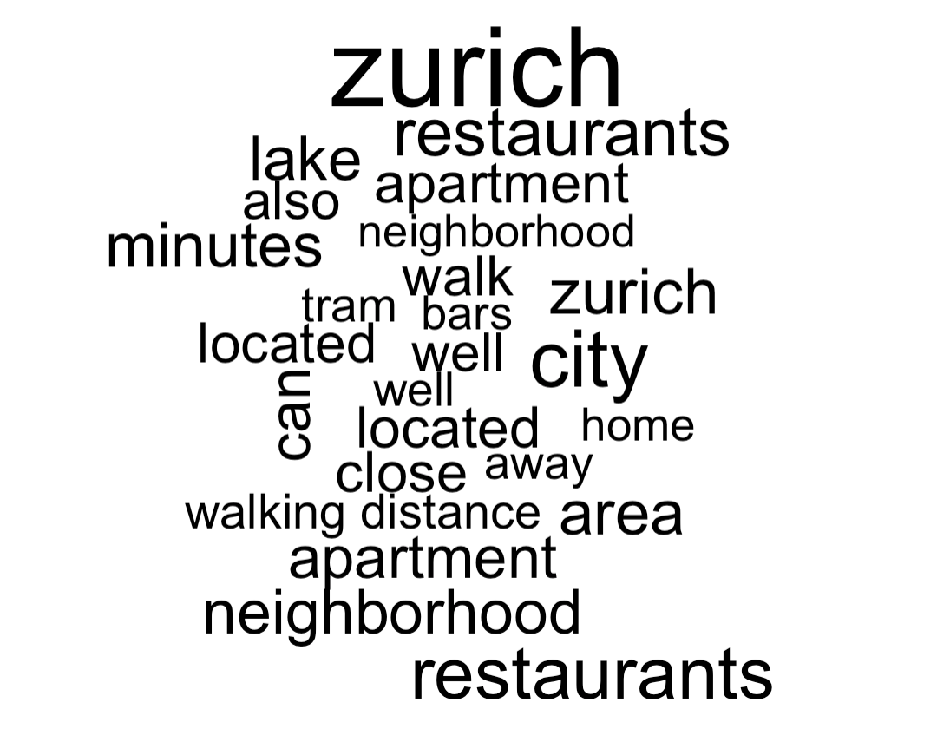
CHARACTERISTICS OF ADVERTISEMENTS

Slide 14
·03·
PREDICTIONS

Slide 15


OBJECTIVE
Create a multiple linear regression model that predicts the rental unit price based on Airbnb rental unit features in Zurich.

Slide 16
Variable Selection
review_rating
guestsPerBed
guestsPerBath
Accommodates
Room/Property Type
NumberOfAmenities
neighbourhood_group_cleansed
Selection Process: Utilization of theoretical insights and empirical data analysis including correlation matrices and univariate regressions, ensuring significant influence on pricing.

Slide 17
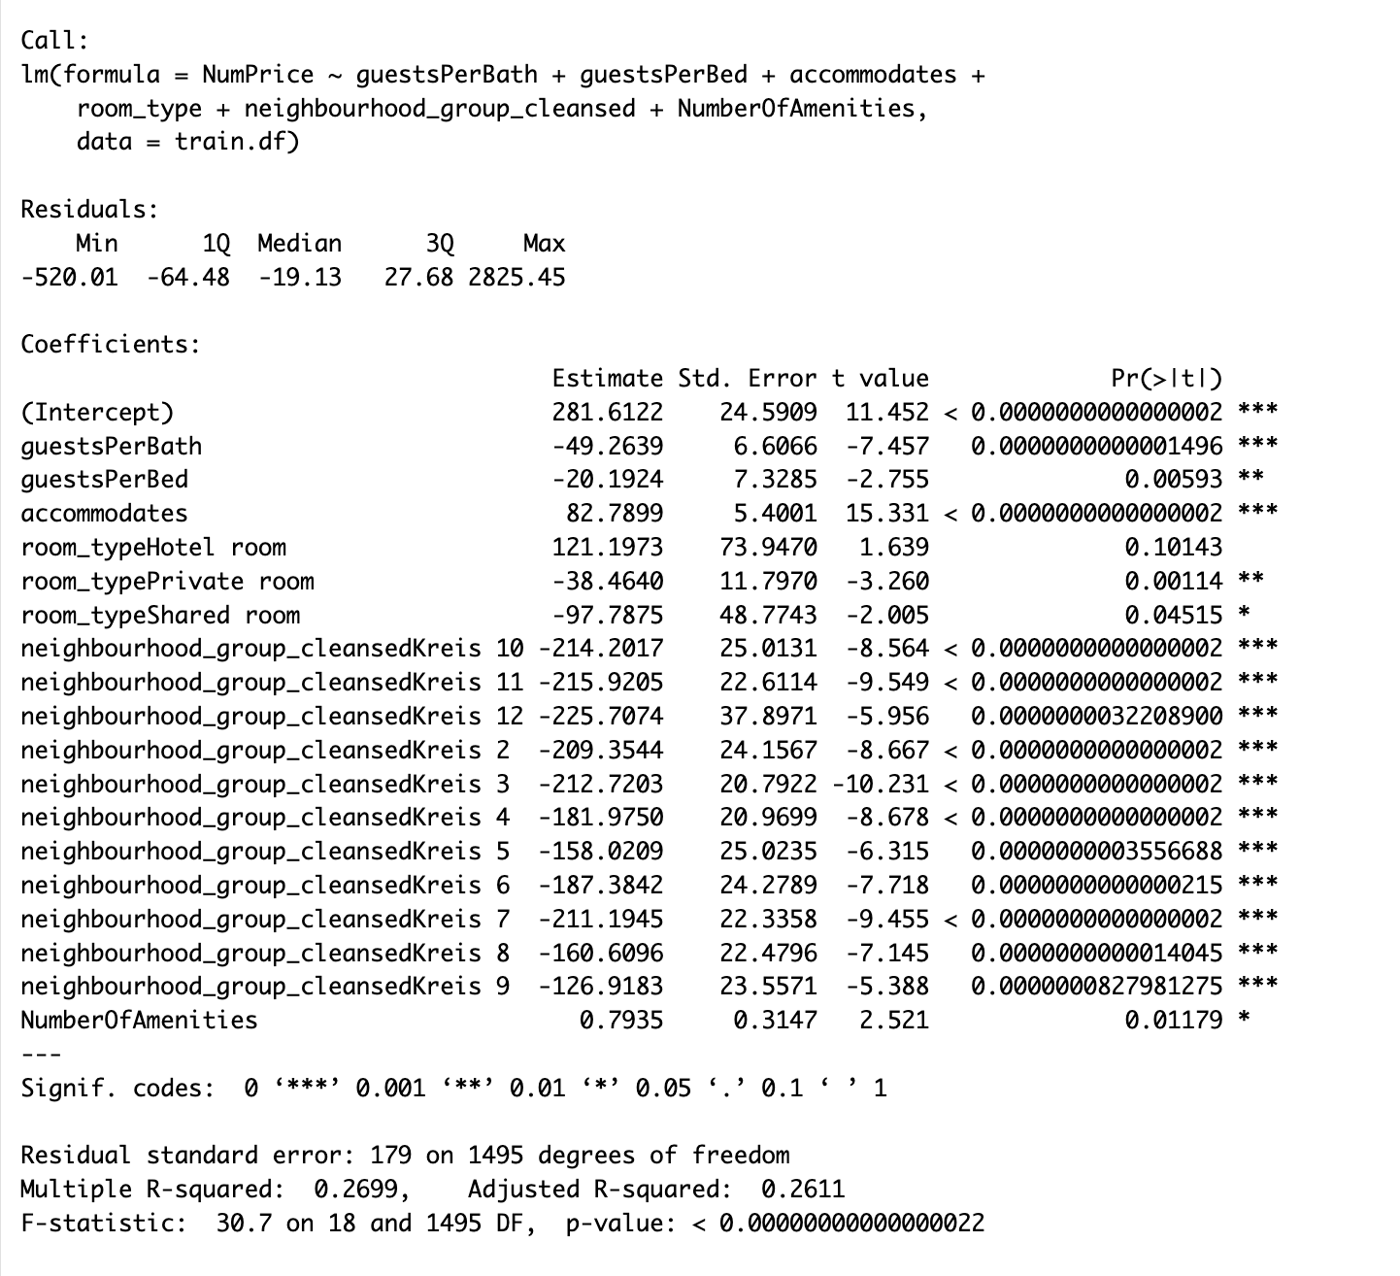
Model Summary -Backward Elimination
Key Insights:
The model explains approximately 26.11% of the variability in Airbnb listing prices (Adjusted R-squared = 0.2611).
F-statistic: Highly significant, indicating the overall model and its predictors significantly impact listing prices.
Accommodates: Listings that can accommodate more guests generally have higher prices due to a positive correlation.
Neighborhood Impact: All evaluated neighborhoods have a negative effect on prices, highlighting notable regional price variations.
Amenities: A minor positive effect is observed with the number of amenities, though the impact on price is modest.
Room Type Influence: Hotel rooms slightly increase prices but not significantly, while private and shared rooms decrease them, especially shared rooms which have a more noticeable drop.

Slide 18
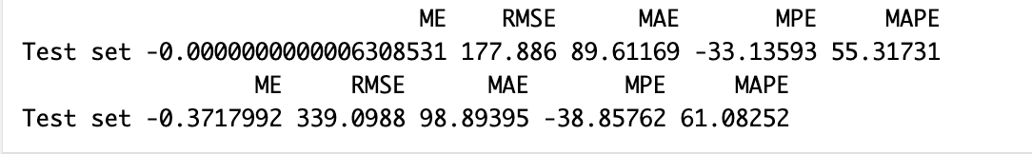
Performance Metrics
The model performs moderately well on the training set but shows decreased accuracy on the validation set, as evidenced by higher RMSE and MAPE. This might indicate potential overfitting or the model's limitations in generalizing to unseen data.
The consistent negative MPE across both datasets suggests that regardless of the training or validation context, the model tends to underestimate the prices, which could be an area for further investigation and model adjustment.

Slide 19
Sample Prediction
guestsPerBed=2
guestsPerBath=2
Accommodates=6
Room/Property Type=”Private”
NumberOfAmenities=10
neighbourhood="Kreis 3"
Price = 396.189

Slide 20
·04·
K-NN

Slide 21
OBJECTIVE
To build a K-Nearest Neighbors model to predict whether a rental listing in a neighborhood has a specific amenity based on several numerical features.

Slide 22



Matrices Involved
K Nearest Neighbours
Numerical Predictors = Beds
Numerical Predictors = Bathrooms
Numerical Predictors = Price
Neighbourhood = Hottingen
Amenity = Wifi

Slide 23
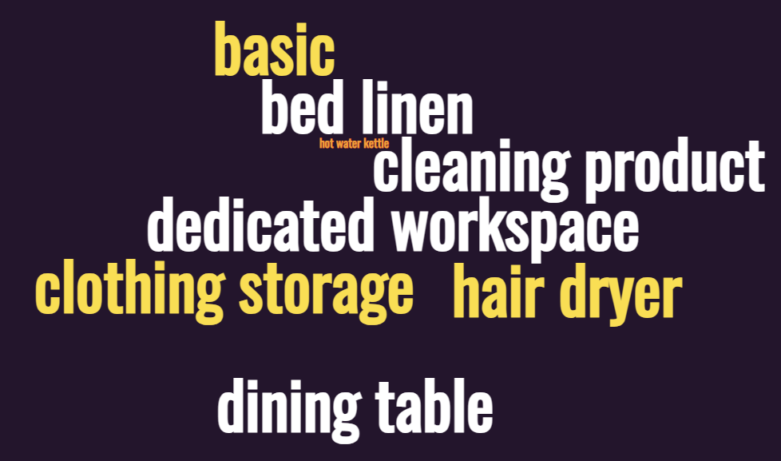
KNN Result
K Nearest Neighbours
Example - (Comfort stay - Moderate Price)
(with most “Hair Dryers” + “Wifi”)
Listings offer various amenities most essential amenities that are likely to influence visitors' preferences as they seek comfort and convenience during their stay. The price of the stay is moderately high

Slide 24
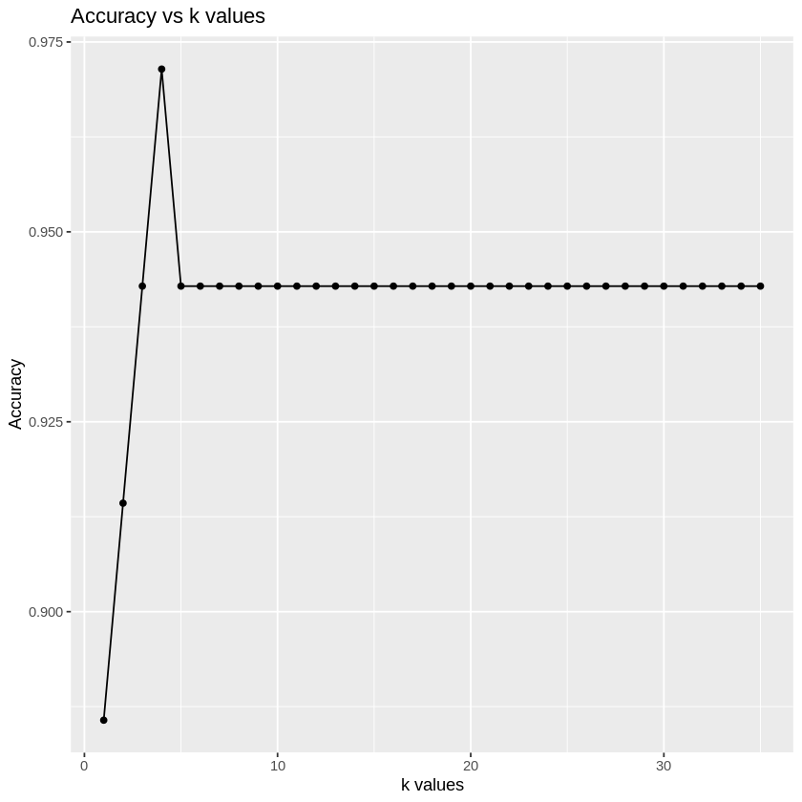
Accuracy vs K-Value
Optimal k value: 4
K Nearest Neighbours
This suggests that the KNN model, with k=4, effectively learned the relationship between the chosen numerical features (Price, Beds & Bathrooms) and the presence of the chosen Wifi in Hottingen.
By considering similar rental listings, the model was able to make accurate predictions for validation data set.

Slide 25
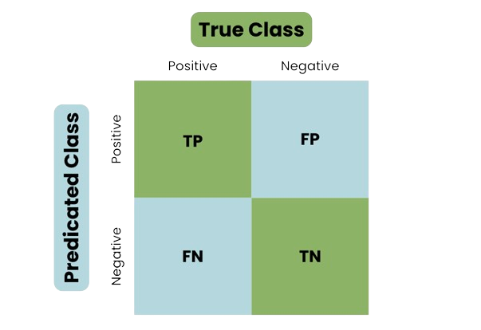
Confusion Matrix
K Nearest Neighbours
Wifi
No Wifi
94.29%
Wifi
Accuracy Rate (Model’s predictions were accurate most of the time for the testing dataset, providing reasonably high level of predictive performance)
1
1
No Wifi
1
32

Slide 26
·05·
NAIVE BAYES

Slide 27
OBJECTIVE
Create a model that predicts guest satisfaction based on Airbnb rental features in Zurich

Slide 28
FEATURES SELECTION
Host Response Time
Host is Superhost
Host has Profile Pic
Host Identity Verified
Room/Property Type
Price Category
Accommodates
Beds
Baths
Number of Reviews

Slide 29
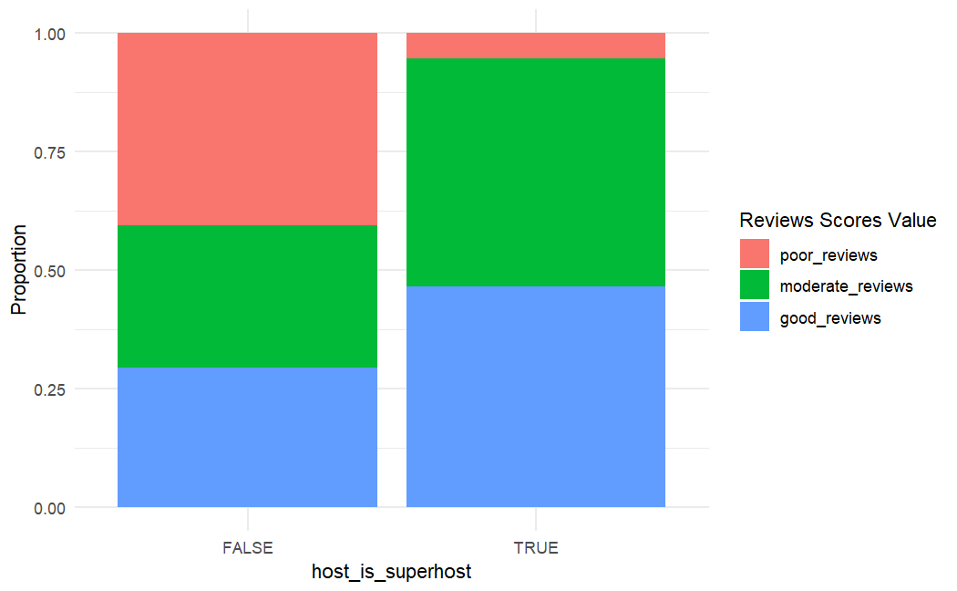
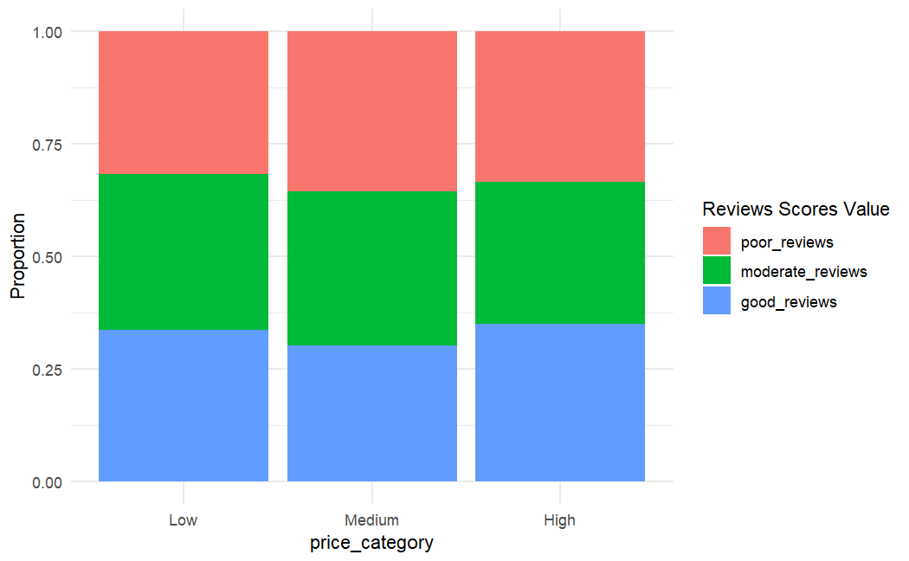
FEATURE DISTRIBUTION
Price Category
Accommodates
Beds
Baths
Host Identity Verified
Notes:
Equal distribution among reviews scores and the features

Slide 30
MODELS
MODEL TRAINING
CONFUSION MATRIX
Equal frequency binning to categorize Review Scores Value
Binning simplifies data by grouping attributes to provide clearer insights and improve accuracy of predicting satisfaction
Accuracy: 62.25%
Accuracy of predictions
Sensitivity: how well the model identifies actual positives
Specificity: model's ability to recognize actual negatives
Reviews | Sensitivity | Specificity
Poor | 75.27% | 87.26%
Moderate | 60.22% | 80.22%
Good | 51.09% | 75.94%

Slide 31
PREDICTION
Host Response Time
Host is Superhost
Within a few hours
TRUE
Room/Property Type
Host has Profile Pic
TRUE
Entire rental unit – Entire home/apt
Number of Reviews
High
MODERATE REVIEW

Slide 32
·06·
CLASSIFICATION TREES

Slide 33
OBJECTIVE
Build a classification tree that predicts the Host Response Time variable

Slide 34
FEATURES SELECTION
Instant Bookable
Host is Superhost
Host Identity Verified
Room Type/Property Type
Host Response Time

Slide 35
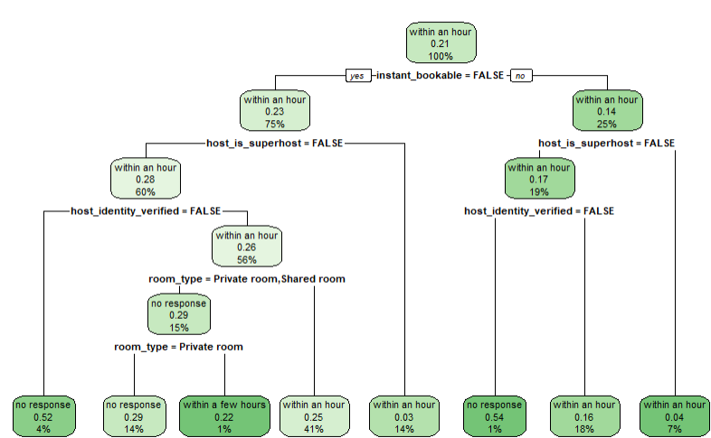
Classification Trees
Insights:
Identified optimal (cp) value (0.0076 through cross-validation.
Strong performance in predicting quick responses ("within an hour").
Struggled with predicting less common response times ("a few days or more").
Understanding factors impacting response time can help Airbnb identify areas for improvement on the platform to encourage faster responses.

Slide 36
·07·
CLUSTERING

Slide 37
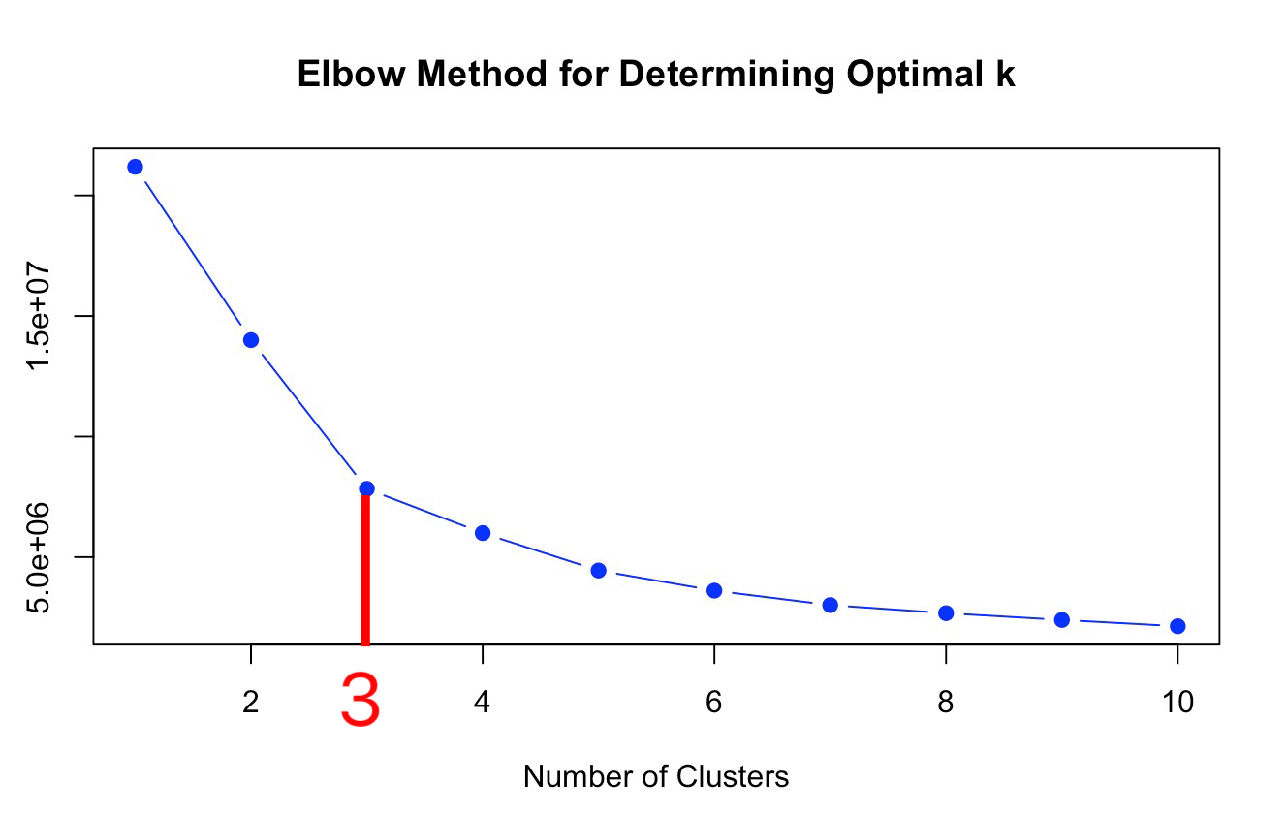
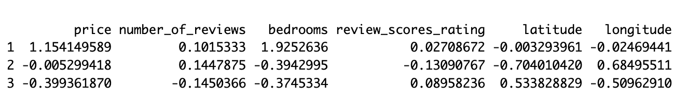
Kmeans Clustering
Objective
Variables
To place rental units within Zurich into clusters to discover underlying patterns and groupings in the data.
Price, Numbers of review,Bedrooms, Review score rating
clusters$centers
3
K = 3 Clusters

Slide 38
HOTEL CHAIN
Clusters
SINCE 1930
Cluster 1
Cluster 2
Cluster 3
“Premium and Popular"
More expensive listings
More bedrooms
High number of reviews
"Economical and Cozy"
Balance between quality and cost
Average satisfaction
"Moderate and Satisfactory"
Budget friendly
Average number of bedrooms
Well-reviewed

Slide 39
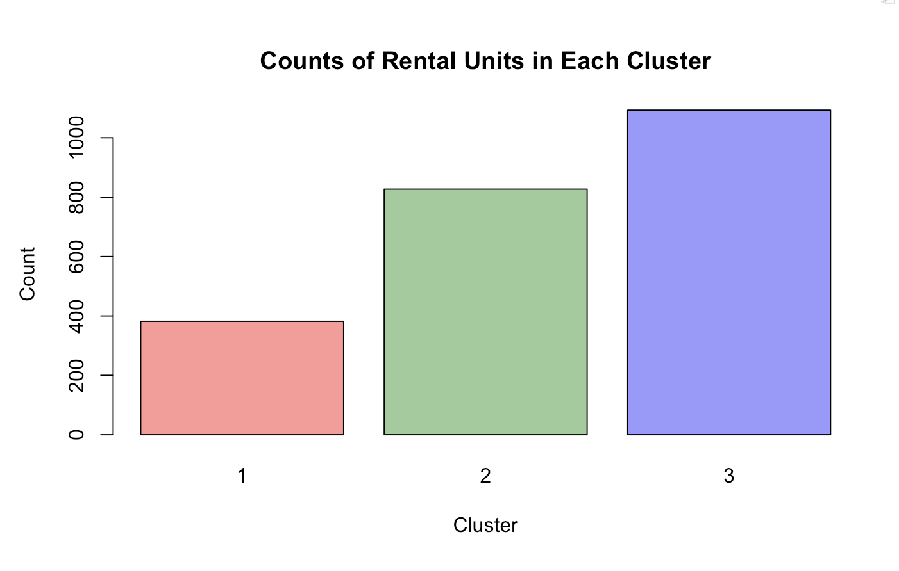
Histogram
High-priced, larger accommodations are less common or in lesser demand.
Travelers prioritizing affordability without sacrificing comfort.
Majority people choose airbnb in Zurich more focus on the moderate price, well-reviewed place to stay

Slide 40
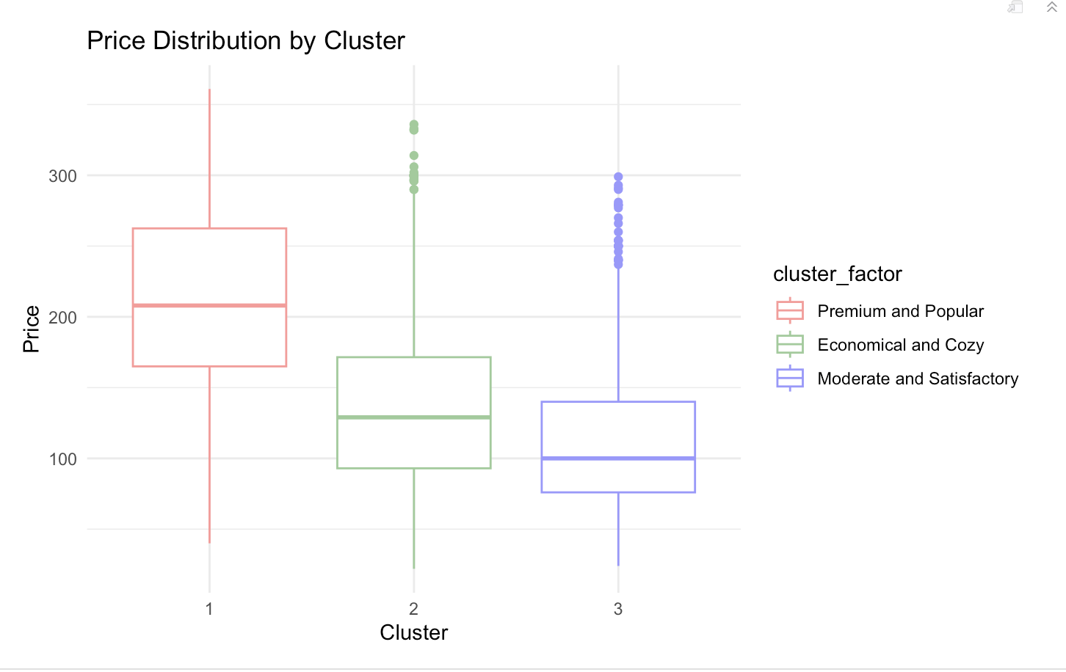
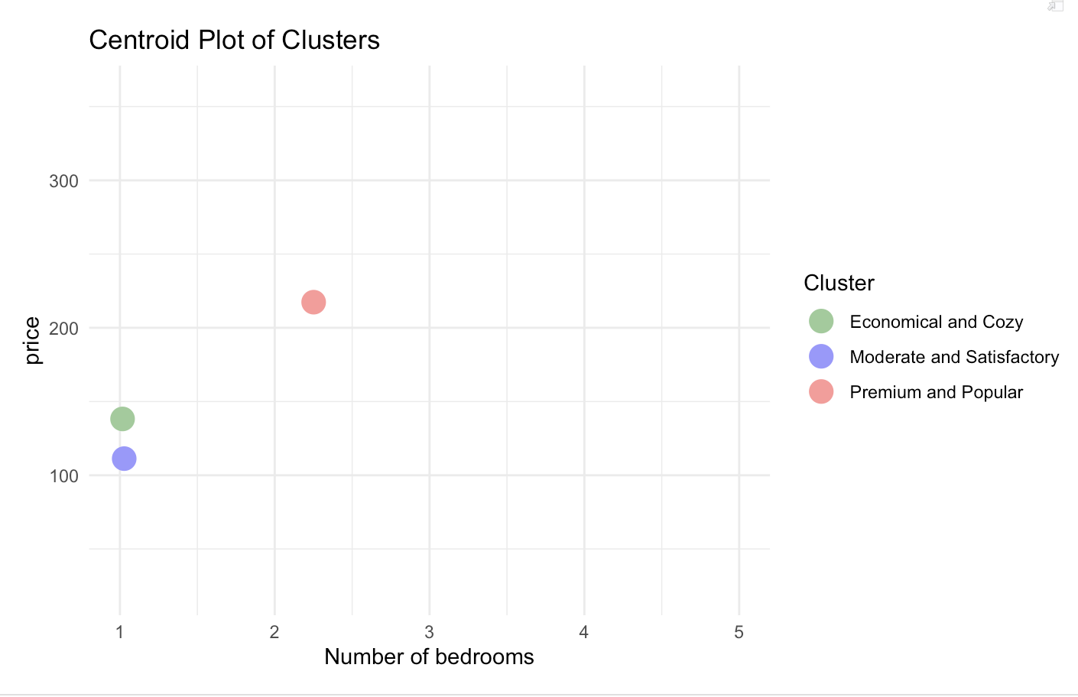
Boxplot & Scatterplot
Visualizes the price distribution across three distinct clusters of Airbnb listings in Zurich
From luxury and spacious accommodations to modest and budget-friendly options, catering to diverse traveler needs and preferences.

Slide 41
CONCLUSIONS

Slide 42
Who will this analysis help?
Airbnb Hosts will benefit by:
Optimizing their listings to align with market trends.
Setting competitive prices and improve services based on factors influencing guest satisfaction.
Targeting specific market segments, improving marketing strategies and booking rates.
Create strategies to enhance guest experiences and competitiveness in the market.

